Slide 1
Art of Database refactoring
Prafulla Girgaonkar

Slide 2
Questions? Anytime …

Slide 3
Common pain Points
Query running slow
Query was running okay but recently it has slowed down
Query misbehaves only on one instance of database
I know query basic only.
I do not understand long queries.
Query runs well on my machine. But it does not in higher environment

Slide 4
Common Observations
Query is not written well
Query logic is not well thought
The data requirement is not well understood.
I missed Index.
I have index but it is not getting used.
And so on..

Slide 5
Terms to know
Index, Keys , Constraints
Regular Index
Covered Index
Selectivity
Derived tables
Deterministic & Non-deterministic predicates
Types of predicates
Query Plan

Slide 6
Index , Primary Key..
An index is the copy of set of columns from the table that can improve search operation when predicates include them.
An Index can be UNIQUE and NON-UNIQUE
UNIQUE is equivalent to SET in java, ensuring no-duplicate-records
NON-UNIQUE can contain duplicates

Slide 7
Index , Primary Key..
Primary Key is a set of columns from a table that help identify a record uniquely. Primary key columns must not be NULL.
There can be only one Primary key.
If there is a surrogate key on the table then UNIQUE INDEX will help ensure unique identity of each column if needed.

Slide 8
Cardinality.
Cardinality of an Index is the number of UNIQUE values it can have
Consider the table – COMPANY
CREATE TABLE [dbo].[company](
[comp_no] [dbo].[numeric_id] IDENTITY(1,1) NOT NULL, -- primary key ( Surrogate)
[comp_name] [dbo].[normstring] NOT NULL, – UNIQUE INDEX
[numberOfemployees] number not null
);
Table has 500 rows. i.e. We shall have 500 unique entries for COMP_NO and COMP_Name
Hence the cardinality will be 500 for those columns
If numberOfEmployees column contains 15 unique values then 15 is the its cardinality.

Slide 9
Selectivity.
Selectivity of an Index = number of UNIQUE values / Total number of values.
Consider the table – COMPANY
CREATE TABLE [dbo].[company](
[comp_no] [dbo].[numeric_id] IDENTITY(1,1) NOT NULL, -- primary key ( Surrogate)
[comp_name] [dbo].[normstring] NOT NULL, – UNIQUE INDEX
[numberOfemployees] number not null
);
Table has 500 rows. i.e. We shall have 500 unique entries for COMP_NO and COMP_Name
Hence the SELECTIVITY will be 1 for those columns
If numberOfEmployees column contains 15 unique values then its selectivity = 15/500 = 0.3
Higher the selectivity better is the use of index
Lower Selectivity can result in FULL TABLE SCAN.

Slide 10
Derived Tables
Derived tables are in-memory table.
The term is famous in MYSQL.
Being in the memory, they queries will run faster.
Developer needs to be cautious when she uses DERIVED Tables.
They should be small in size.
Bigger derived tables will lead to larger memory requirement or may result in using virtual memory.
They will be available through the scope of the query in which they are created.
They help you create smaller sets to make query faster if used smartly.

Slide 11
Predicates
Predicates are conditions that help narrow down the data.
They are of two types
JOIN predicate
Select a.name , b.value from T1 a inner join T2 b on a.name = b.name;
FILTER predicate
Select a.name , b.value as values_less_than_ten from T1 a inner join T2 b on a.name = b.name where b.value < 10;

Slide 12
Predicates
Predicates are conditions that help narrow down the data.
Predicates can be
DETERMINISTIC
Select a.name , b.value as values_less_than_ten from T1 a inner join T2 b on a.name = b.name where b.value < 10;
NON-DETERMINISTIC.
Select a.name , b.value as values_less_than_ten from T1 a inner join T2 b on a.name = b.name where b.value < average(some_other_column);

Slide 13
Query Plan
It is also called Query Execution Plan
It can be ESTIMATED or ACTUAL.
When a query is submitted for execution, QUERY OPTIMIZER analyses query , participating tables, predicates.
Optimizer comes up with various alternate plans to execute the query.
Since OPTIMIZER is imperfect, these plans are optimal and suboptimal as well.
At the end OPTIMIZER selects the best alternative.
Not every time, the execution plan is the best performing. Hence developers/administrators need to look at the carefully.

Slide 14
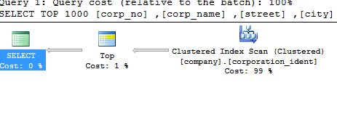
Query Plan – SQL Server

Slide 15
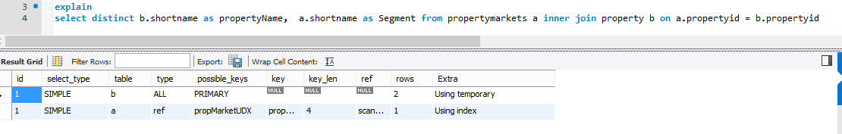
Query Plan – MYSQL Server

Slide 16
Logical Query Processing
Interactive

Slide 17
Query practical

Slide 18
Knowing data well before writing query
Every module/application has a well-designed data flow.
If the flow is not thought through then data set will be a big chaos. It will not be organized well.
If the scope of the module is large enough, then at every step the data flow will be
Adding data
Removing data
Summarizing data
Exploding data
At various stages some of data points are omitted or newly added to consideration.

Slide 19
Knowing data well before writing query
A well designed data flow follows a discipline.
If a developer understands the discipline correctly, the query she develops will be efficient.
In addition to flow, if she also pays attention to the volume of data in possible scenarios, query designed will be best performing.

Slide 20
Few more thoughts
When constructing a SQL query, it is important to ask for exactly what you need.
Designing for “just-in-case” scenario can lead to performance degradation.
Developers can be reluctant about questioning the requirements. A simple validation of requirement can pay large dividends

Slide 21
Keep predicate deterministic
There is a financial transaction information. Each transaction has AMOUNT associated with it.
Requirement is to identify transactions for which the double the AMOUNT is less than 100;
select transaction_id, amount
from transactions
where amount * 2 < 100;
select transaction_id, amount
from transactions
where amount < 100 / 2;

Slide 22
Keep predicate deterministic
There is a customer information.
For each customer, information covered is
First Name
Middle name
Last Name
Issue Date
Requirement is to identify customer with name “Naresh Jain”;
select member_no, firstname + middleinitial + lastname, issue_dt
from customer
where firstname + ' ' + lastname = 'Naresh Jain';
select member_no, firstname + middleinitial + lastname, issue_dt
from customer
where firstname = 'Naresh'
and lastname= 'Jain';

Slide 23
Select * from …
Find the Customers in JAPAN
select *
from customer inner join region on customer.region_no = region.region_no
where region_name = 'JAPAN';
Do we need all information or just few columns?
Oh..Let me correct it.
Find the FULL NAMES of customers in JAPAN
select region.region_name as Region, FirstName + ' ' + lastname as FullName
from customer inner join region on customer.region_no = region.region_no
where region_name = 'JAPAN';

Slide 24
Avoid - Select * from…
Narrow down data as far as possible
Avoid STAR(*)
USE TOP
Know your data
You deal with to fetch
Fetched data.

Slide 25
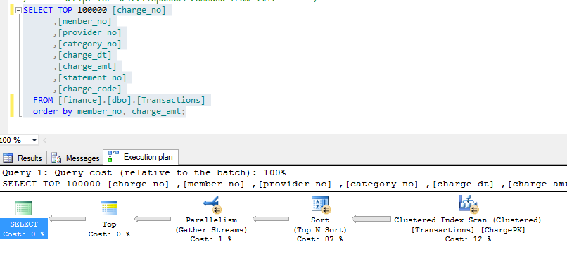
Is SORT needed?
Sorts are costly.
Use them sparingly

Slide 26
Use Distinct If needed
Distinct is also a costly operation
When you decide to use DISTINCT, always the requirement and context in which it is used.
Also check the table on which you plan to run it.
Example : Refer to initial exercise.

Slide 27
Union or Union ALL
UNION will merge 2 data sets will keep ONE row for common rows in both sets.
UNION will avoid duplication.
UNIONALL will merge 2 data sets as is
In case of UNIONALL, duplicate rows are possible

Slide 28
Wild Chars in predicates
SELECT top 100000 [member_no],[lastname] ,[firstname],[middleinitial],[street],[city]
,[state_prov],[country],[mail_code],[phone_no]
,[photograph],[issue_dt],[expr_dt],[region_no]
,[corp_no],[prev_balance],[curr_balance],[member_code]
FROM [finance].[dbo].[customer]
where lastname like 'A%';
SELECT [member_no],[lastname] ,[firstname],[middleinitial],[street],[city]
,[state_prov],[country],[mail_code],[phone_no]
,[photograph],[issue_dt],[expr_dt],[region_no]
,[corp_no],[prev_balance],[curr_balance],[member_code]
FROM [finance].[dbo].[customer]
where lastname like '%A%';

Slide 29
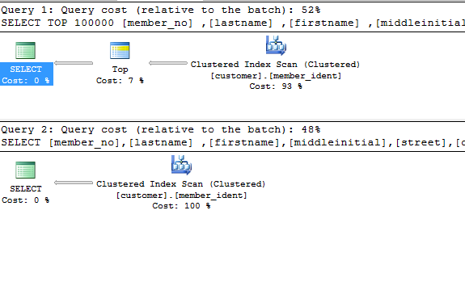
Wild Chars in predicates

Slide 30
Hidden Cartesian product
--80 000 000 rows found
select COUNT(*) FROM
(SELECT
b.member_no, b.firstname, b.lastname, e.region_name, e.region_no,
d.provider_name, a.category_desc,
c.charge_no,c.category_no,c.charge_amt, c.charge_dt
from
category a,customer b,Transactions c, provider d,region e
where
b.member_no = c.member_no and b.region_no = e.region_no and
a.category_no = c.category_no) CC;
-- 1 600 000 rows found
select count(*) from (
select
b.member_no, b.firstname, b.lastname, e.region_name, e.region_no,
d.provider_name, a.category_desc,
c.charge_no,c.category_no,c.charge_amt, c.charge_dt
from
Transactions c
inner join category a on c.category_no = a.category_no
inner join customer b on c.member_no = b.member_no
inner join provider d on c.provider_no = d.provider_no
inner join region e on e.region_no = b.region_no
) aa

Slide 31
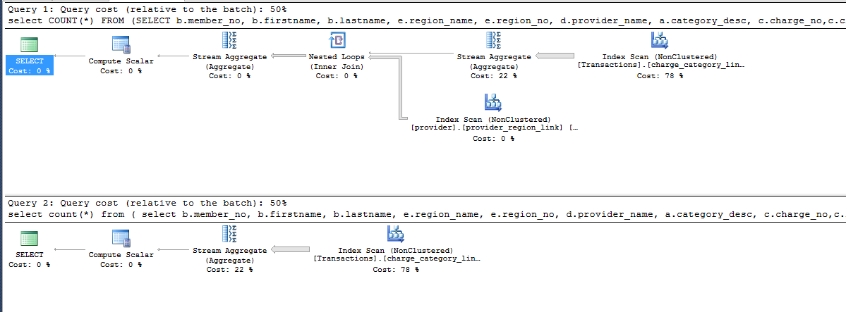
Hidden Cartesian product

Slide 32
Avoid ONE BY ONE Row handling..
Think in terms of SETS
Not “row by row”
Say the requirement is
For all rows that have CHARGE_NO ending with 5 set the CHARGE_CODE as XY.

Slide 33
Avoid ONE BY ONE Row handling..
DECLARE @charge_code VARCHAR(2);
DECLARE @CursorVar CURSOR;
SET @CursorVar = CURSOR SCROLL DYNAMIC
FOR
SELECT top 500 charge_code
FROM [finance].[dbo].[Transactions]
where [charge_no] % 10 = 5;
OPEN @CursorVar;
FETCH NEXT FROM @CursorVar into @charge_code;
WHILE @@FETCH_STATUS = 0
BEGIN
set @charge_code = 'XY';
FETCH NEXT FROM @CursorVar into @charge_code;
END;
CLOSE @CursorVar;
DEALLOCATE @CursorVar;

Slide 34
Avoid ONE BY ONE Row handling..
update top (500) [finance].[dbo].[Transactions] set [charge_code] = 'XY' where [charge_no] % 10 = 5;

Slide 35
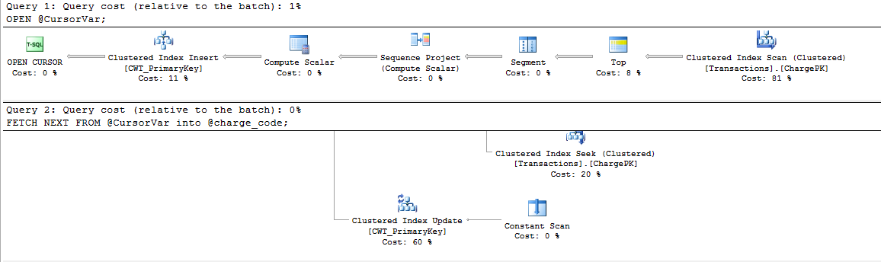
Avoid ONE BY ONE Row handling..

Slide 36
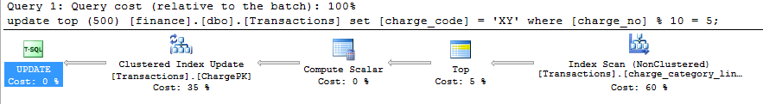
Avoid ONE BY ONE Row handling..

Slide 37
Points
Audience poll.
Refactoring query without changing out put.
Statistics needed
Discussion – Is surrogate key needed?

Slide 38
Thank you!

